Slide 1

Chapter 10
JavaScript

Slide 2
Learning Objectives
Using JavaScript, web developers perform client-side processing that may include CSS field modification, form validation, JQuery operations, and more.
To place JavaScript code within an HTML file, you use the <script> and </script> tag pair.
JavaScript is a programming language with a syntax that defines the rules a programmer writing JavaScript code must follow. If you violate the syntax, the script will not execute and you will need to determine the and correct the cause of the error.
As developers write JavaScript code, they should comment their processing so that another developer who reads the code can readily understand it.
JavaScript provides operators to perform common arithmetic operations, such as addition, subtraction, multiplication, and division.

Slide 3
Learning objectives continued
To allow programs to make decisions, JavaScript supports conditional processing via the if-else and switch statements.
To allow programs to repeat statements, JavaScript provide iterative processing via the for, while, and do while statements.
To allow programs to store information as they execute, JavaScript allows programmers to define and use variables.
JavaScript is a case-sensitive language which means it treats upper and lowercase letters and distinct.
To make their code easier to read, JavaScript developers use indentation and whitespace characters and blank lines.
Using an Array object, JavaScript programs can store multiple values within a single variable.
JavaScript provides several built-in objects, such as the Date and String objects which provide access to common operations such as getting the current system date and time.
Using the new operator, JavaScript programs can create their own objects.

Slide 4
Learning objectives continued
To simplify large programming tasks, JavaScript developers often break the tasks into smaller pieces which they implement using functions.
To handle events, such as user mouse or keyboard operations, users can specify a JavaScript function the browser will call when the event occurs.
Before a web page submits a form’s data to a remote script, the page should use JavaScript to validate that the user has provided a value for the form’s required fields.

Slide 5
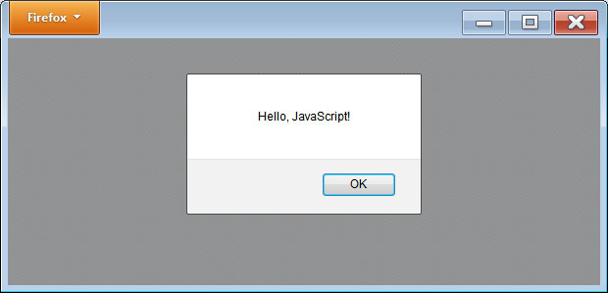
Simple javaScript--Hello
<!DOCTYPE html> <head> <script> alert('Hello, JavaScript!'); </script> </head> <body> </body> </html>

Slide 6
Javascript old Syntax
In the previous example, the HTML file placed a <script> and </script> tag pair within the document’s head section. The <script> tag is HTML 5 format. As you examine older JavaScript code within HTML files, you will encounter <script> tags in the following form:
<script type="text/javascript"> // code here
</script>
In this case, the type=“text/javascript” attribute tells the browser that the script that follows will be JavaScript. Although this format still works, HTML 5 has simplified it, making JavaScript the default scripting language.

Slide 7
Sequential processing
<!DOCTYPE html> <head> <script> alert('Hello'); alert('JavaScript World!'); </script> </head> <body> </body> </html>

Slide 8
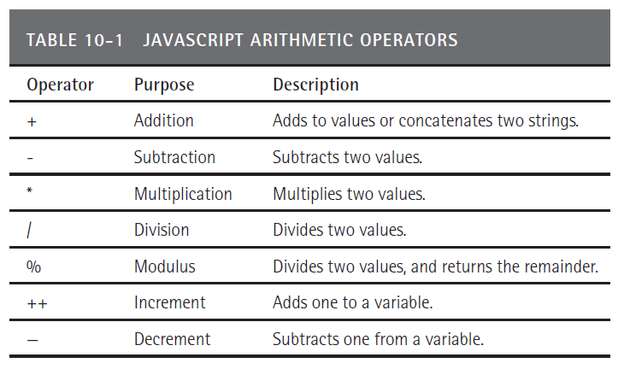
Javascript operators

Slide 9
Math operations
<!DOCTYPE html> <head> <script> alert(3+4); alert(3*4); alert(3/4); </script> </head> <body> </body> </html>

Slide 10
variables
Programmers store such temporary values using named locations in memory called variables.
In the simplest sense, a variable is the name of a storage location in memory. In other programming languages, you have to provide specifics about the memory location, such as the size of the value the location will hold as well as the type of value, such as a number, date, or sequence of characters.
JavaScript, in contrast, is a “loosely typed” programming language which means you simply need to specify a variable name, but not a related data type. To declare a JavaScript variable, you use the var keyword followed by a variable name. The following statement creates a variable named message:
var message;

Slide 11
Variable declaration
When you declare variables within JavaScript, you can specify the names of several variables within one statement:
var Username, OrderDate, GraphicsFile;
Or, you can individually declare each variable:
var Username; var OrderDate; var GraphicsFile;

Slide 12
Assigning a value to a variable
After you declare a variable, you can use the equal sign, which is the JavaScript assignment operator, to assign a value to the variable:
var Age; Age = 21;
In this case, the code used two statements to declare and then to initialize the variable Age. You can also perform both operations in one statement, as shown here:
var Age = 21;

Slide 13
Variable types
When you assign a value to a variable, the type of value you assign may differ. The following statements assign an integer, floating-point, and character-string value to different variables:
var Age = 21; var Salary = 35000.00; var Name = ‘Jane Doe’;
As you can see, the variable Age is assigned the integer value 21. An integer value is essentially a counting number. The following statement assigns the value 35000.00 to the variable Salary.
Developers refer to numbers with a decimal point as a floating-point number. Finally, the last statement assigns a name, contained in single quotes to the variable Name.
Programmers refer to characters contained between quotes as a string.

Slide 14
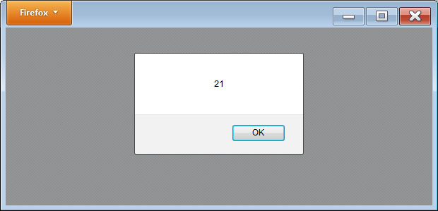
Displaying variables
<!DOCTYPE html> <head> <script> var Age = 21; var Salary = 35000.00; var Name = 'Jane Doe'; alert(Age); alert(Salary); alert(Name); </script> </head> <body> </body> </html>

Slide 15
comments
When developers specify program statements, the developers should comment or document their code to explain the processing that it performs. To comment your JavaScript code, you can use two techniques. First, you can comment one line at a time, by placing double slashes:
var Age = 21; // Assume the user is 21-years old
When JavaScript encounters the double slashes that starts the comment, JavaScript will ignore the characters that follow, up to the end of the line, assuming they are simply messages to other programmers who are reading the program statements.

Slide 16
Sample comments
Many programmers will place several lines of comments at the start of their code that explain who wrote the code, when, and why:
// Written by: Kris Jamsa // Written: 09/30/13 // Purpose: Prompt the user for their age and display appropriate content
The second way to comment JavaScript code is to use the /* and */ comment tag pair. When JavaScript encounters the characters /* it will ignore the characters that follow until it encounters the characters */.
/* Written by: Kris Jamsa Written: 09/30/13 Purpose: Prompt the user for their age and display appropriate content */

Slide 17
If statement
if (SomeConditionIsTrue) statement; if (SomeOtherConditionIsTrue) { statement01; statement02; }

Slide 18
If-Else statement
<!DOCTYPE html> <head> <script> var Age; Age = prompt('Enter an Age'); if (Age >= 21) alert('This Buds for you!'); else alert('No Buds for you!'); </script> </head> <body> </body> </html>

Slide 19
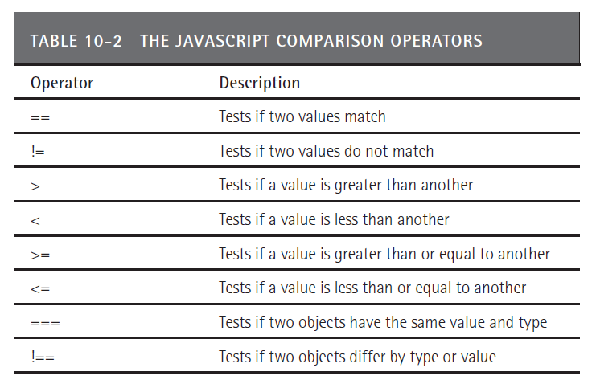
Comparison operators

Slide 20
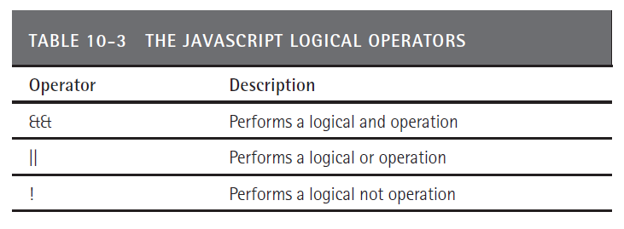
Logical operators

Slide 21
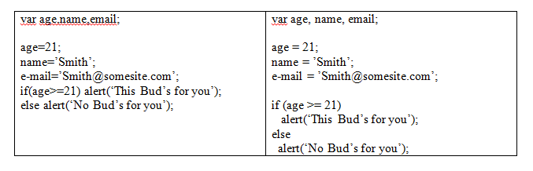
Using whitespace

Slide 22
Switch statement
switch (pet) { case ‘dog’: alert(‘Dogs are great’); break;
case ‘cat’: alert(‘Cats are great’); break;
case ‘fish’: alert(‘Fish are great’); break;
case ‘horse’: alert(‘Horses are great’); break;
default: alert(‘You should get a pet!’);
}

Slide 23
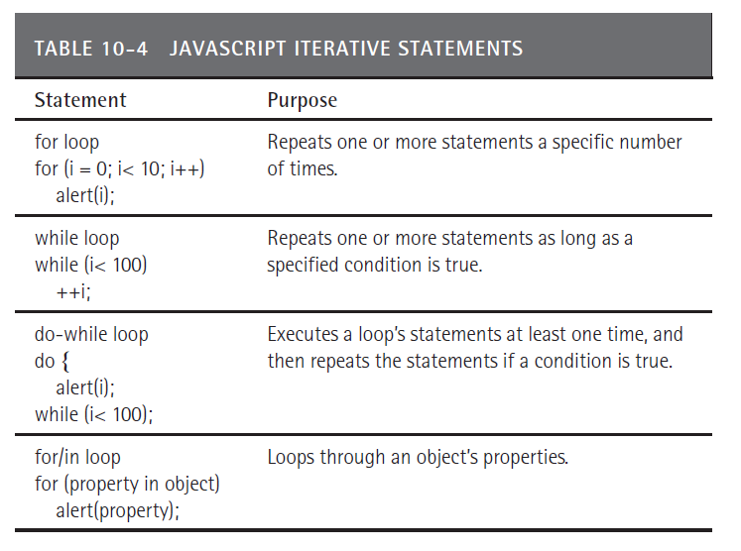
Iterative statements

Slide 24
functions
To program large or complex tasks, programmers often break the tasks into smaller pieces which they can implement using a group of related statements called a function. In the simplest sense, a function contains the statements for a set of instructions that accomplish a specific task.
To create function within JavaScript, developers use the keyword function followed by the function name and parenthesis which specify values passed to the function, called parameters. The developer then groups the function statements within left and right braces:
function SomeFunctionName(parameter01, parameter02) { // function statements }

Slide 25
Function example
<!DOCTYPE html> <head> <script> function SayHello() { alert('Hello'); } function ShowMessage(message) { alert(message); } SayHello(); ShowMessage('I like Java!'); </script> </head> <body> </body> </html>

Slide 26
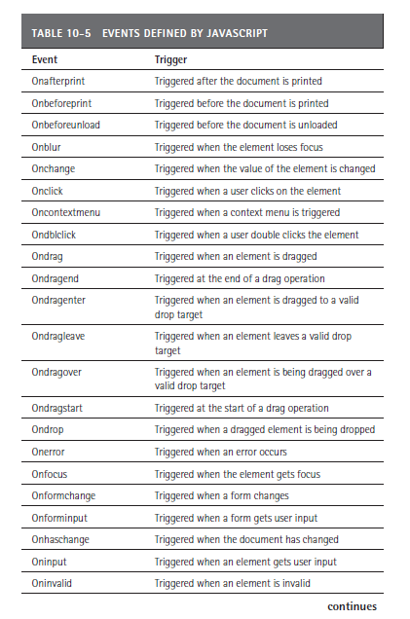
Events

Slide 27
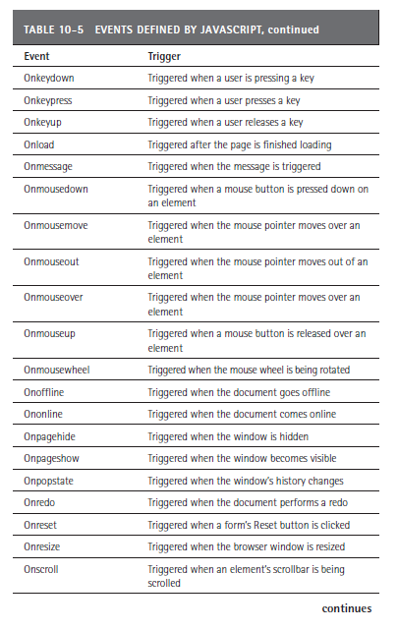
Events continued

Slide 28
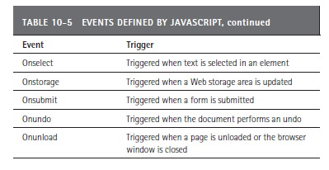
Events continued

Slide 29
Returning a value from a function
function MinValue(A, B) { if (A < B) return(A); else return(B); }

Slide 30
Declaring variables within a function
function SomeFunction() { var Name, Age, Email; }

Slide 31
Global variables
var TitleGlobalVariable = ‘HTML 5 Web Development’;
function ShowBook() { alert(TitleGlobalVariable); }

Slide 32
Creating an array
To create an array variable, you create an Array object as shown here:
var Names = new Array();
After you declare an array variable, you can then assign values to the indexed locations:
Names[0] = ‘Smith’; Names[1] = ‘Jones’; Names[2] = ‘Davis’;

Slide 33
An array demo
<!DOCTYPE html> <head> <script> function ShowArray() { var Names = ['Smith', 'Jones', 'Davis']; var i; for (i = 0; i < Names.length; ++i) alert(Names[i]); } </script> </head> <body> <button onclick="ShowArray()">Click Here</button> </body> </html>

Slide 34
Using a date object
<!DOCTYPE html> <head> <script> function ShowDateTime() { var dateVariable = new Date(); alert(dateVariable.toString()); } </script> </head> <body> <button onclick="ShowDateTime()">Click Here</button> </body> </html>

Slide 35
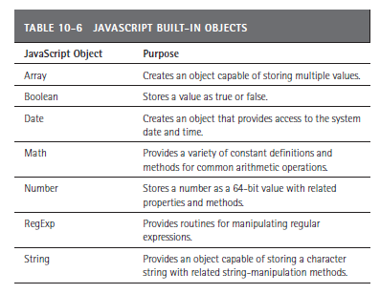
Built-in objects

Slide 36
Creating your own objects
In addition to using the built-in JavaScript objects, you can create your own objects. Assume that you want to create a Student object that contains a name, age, and GPA. To start, you must create a function that is named the same as your object, in this case, Student. The function will receive a parameter for each value the object stores. The Student function, therefore, will receive a name, age, and GPA parameter. Within the function, you will use the “this” object reference to assign the parameter values to the object fields, as shown here:
function Student(Name, Age, GPA) { this.Name = Name; this.Age = Age; this.GPA = GPA; }
After you define the function, you can create objects using the new operator:
var someStudent = new Student(‘Smith’, 21, 3.5); var anotherStudent = new Student(‘Jones’, 20, 3.3);

Slide 37
Object demo
<!DOCTYPE html> <head> <script> function Student(Name, Age, GPA) { this.Name = Name; this.Age = Age; this.GPA = GPA; } function ShowStudents() { var someStudent = new Student('Smith', 22, 3.15); alert(someStudent.Name); alert(someStudent.Age); alert(someStudent.GPA); } </script> </head> <body> <button onclick="ShowStudents()">Click Here</button> </body> </html>

Slide 38
Exernal javascript files
You have used the <script> and </script> tag pair to place JavaScript statements within a page. Often, developers will have a collection of JavaScript routines they use in many pages. Rather than copy the code into each file, the developers will link an external file using a statement similar to the following:
<script src="someFile.js"></script>
In this case, the code links in a file named someFile.js. External JavaScript files normally use the .js file extension. Within the file, you simply place your JavaScript statements without the <script> and </script> tag pair.

Slide 39
Real world: form validation
<!DOCTYPE html> <head> <script> function ValidateForm() { if (document.forms["myForm"]["name"].value==null || document.forms["myForm"]["name"].value=="") { alert("Name must be filled out"); return false; } if (document.forms["myForm"]["phone"].value==null || document.forms["myForm"]["phone"].value=="") { alert("Phone must be filled out"); return false; } if (document.forms["myForm"]["email"].value==null || document.forms["myForm"]["email"].value=="") { alert("Email must be filled out"); return false; } return true; }
</script>

Slide 40
Form validation continued
</head> <html> <body> <form name="myForm" action="http://www.WebsiteDevelopmentBook.com/FormEcho.php" method="post" onsubmit="return ValidateForm()" > Name: <input type="text" name="name" /><br/> Phone: <input type="text" name="phone" /><br/> E-mail: <input type="text" name="email" /><br/> <input type="submit" value="Click to Submit" /> </form> </body> </html>

Slide 41
summary
JavaScript is a programming language you can use to automate tasks within a Web page and to improve the page’s interactivity.
What makes JavaScript unique is that the browser executes the JavaScript statements. As such, developers refer to JavaScript programming as client-side programming.
This chapter introduced the JavaScript programming language. You will make extensive use of JavaScript throughout this book’s chapters to access page elements, to manipulate CSS, to program the HTML 5 canvas, and more.

